Slide 1
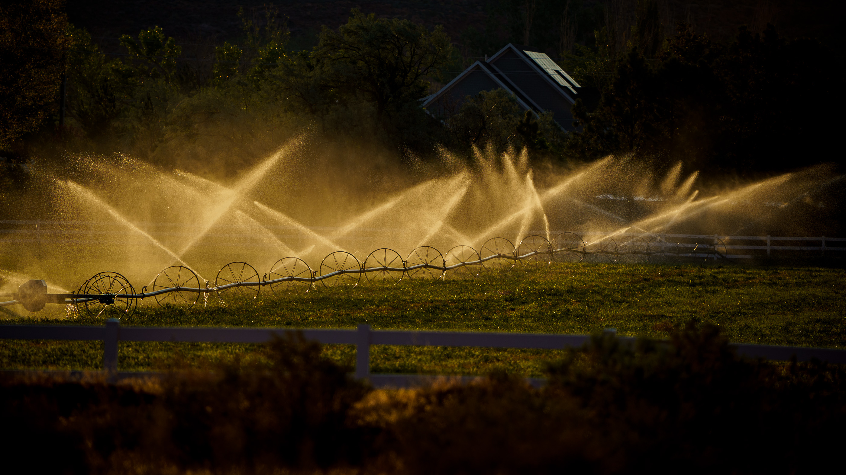
Statistical Analysis on Flow Rate in a Drip Irrigation System
Denis Sholotyuk and Nicholas Knutsen

Slide 2

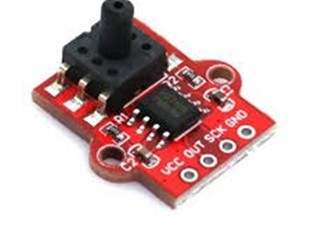
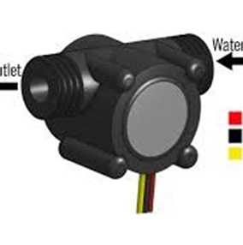
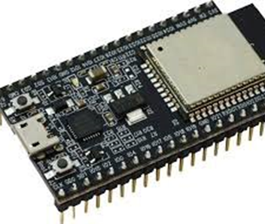
Background
We will be analyzing data from “A simple dataset of Water pressure and flow rate in a drip irrigation system based on Internet of Things measuring tools” (1).
Data was collected from a drip irrigation system using a YF-S201 sensor for water flow rate and an HX710b sensor for water pressure.
Sensor data was processed into kilopascals (kPa) for pressure and liters per minute (L/min) for flow rate using an ESP32 microcontroller while transmitted into a Thingspeak cloud database.

Slide 3
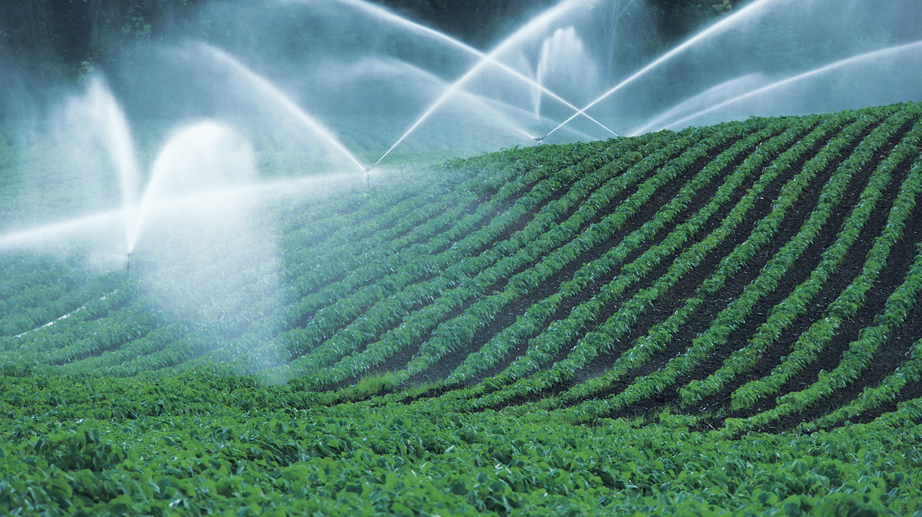
Data
With the collect data, two data sets were produced: raw data and filtered data, with ID, timestamp, inlet and outlet pressure, and flow rate were all stored in a CSV excel file.
The data was preprocessed where duplicate entries were removed to avoid bias, eliminating outliers based on defined optimal ranges of pressure 1: 17.53–37.17 kPa, pressure 2: 5.07–14.86 kPa, and water flow rate: 10.89–51.00 L/min.
The raw dataset contained 1,329 entries and the filtered dataset was reduced to 911 after preprocessing.

Slide 4
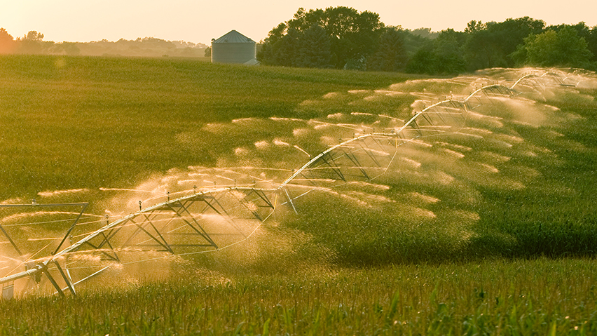
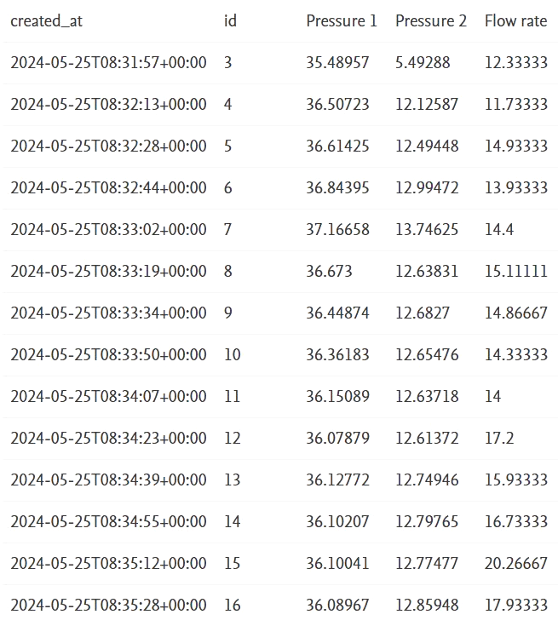
Data Sample

Slide 5
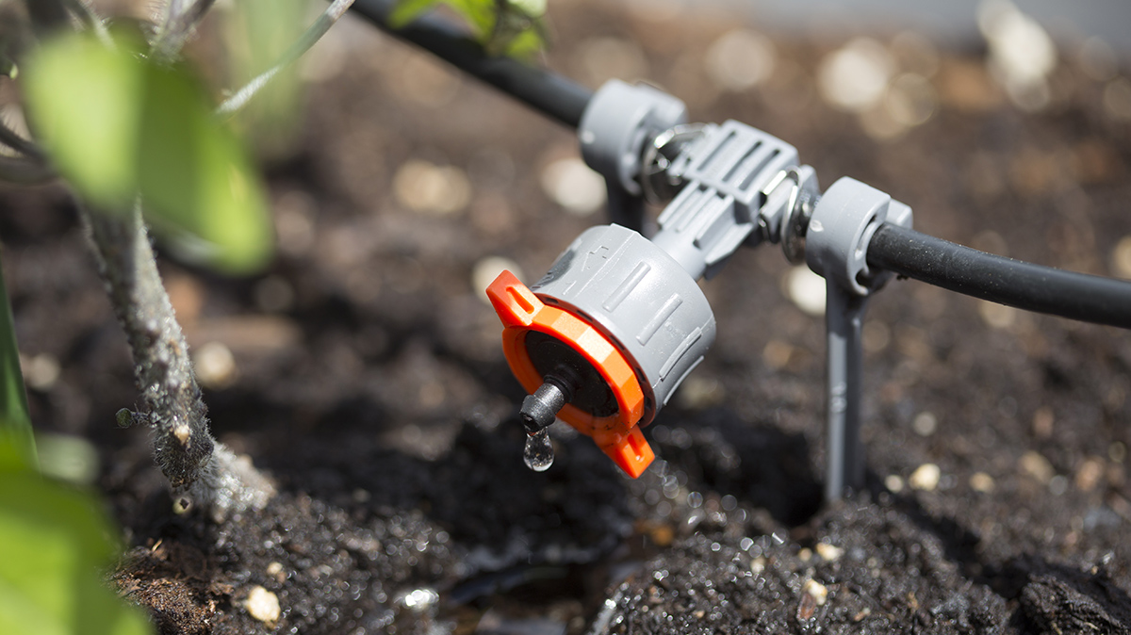
Goal
We are trying to see whether the drip irrigation system exceeds a flow rate of 20 L/min.
We will be performing a t-test with our null hypothesis being the mean flow rate is less than or equal to the target (𝜇 ≤ 20 L/min), and our alternative hypothesis being the mean flow rate is greater than the target (𝜇 > 20 L/min).
This analysis will help us understand the rate at which the drip irrigation system has to the population over a time range.

Slide 6

Method
Objective is to test the mean flow rate of the irrigation system is greater than 20 liters per minute
To Do this we selected the T Test since we are given a known mean of 20 L/m along with a large sample size of 916 with a large degree of Freedom(915) as well as us not knowing population standard Deviation.
Null Hypothesis 𝜇 ≤ 20 𝐿/𝑚𝑖𝑛 liters per minute
Alternative Hypothesis 𝜇 >20 liters per minute
We used the R t.test() function to determine µ

Slide 7
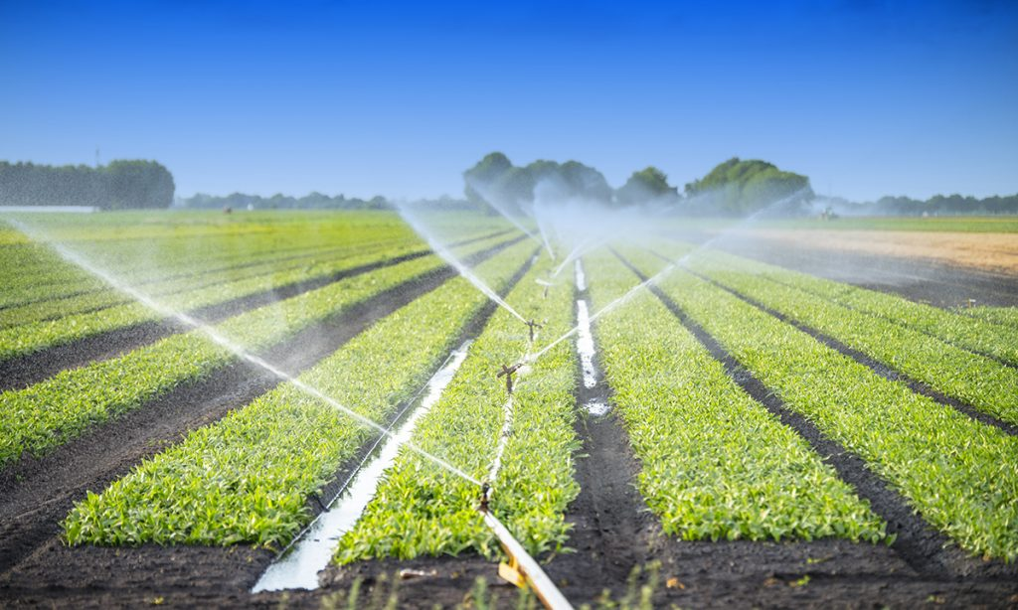
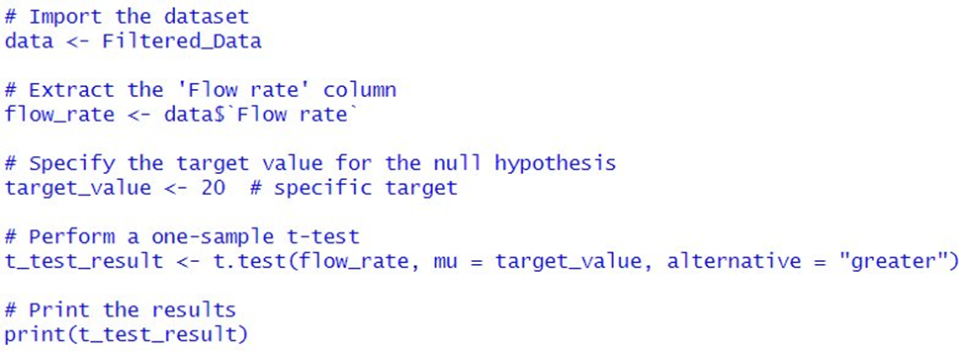
Code

Slide 8

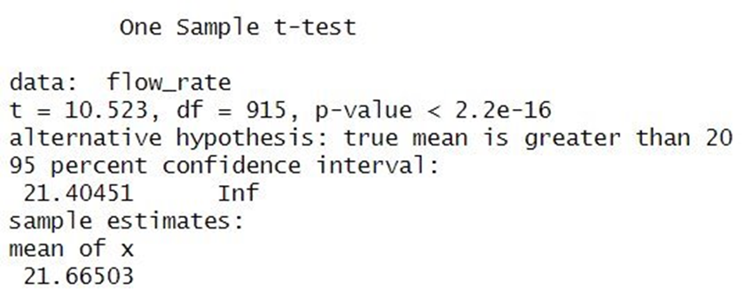
Results
The sample mean of the given data is 21.66503 L/m is slightly greater than predicted value of 20 L/m but is still relatively close.
With a large data set of 916 the degree of freedom is 915 which increases the reliability and strength the T test
Given the calculated T statistic of 10.523 we can conclude that there may be a signifcant difference between the sample mean and the hypothesized mean.
Since the P value is extremely small being 2.2e-16 with 95% confidence, this provides very strong evidence againist the Null hypthesis

Slide 9
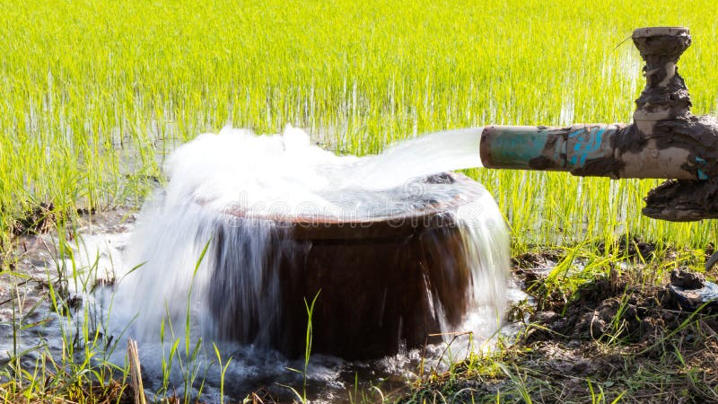
Conclusion
With the t-statistic being 10.523, this concludes that there is a large difference between the sample mean (21.66503 L/min) and the hypothesized mean (20 L/min), meaning that the true mean is most likely much larger.
The statistical decision: Given that the p-value is 2.2e-16, which is much smaller than the significance level of 0.05, we can confidently say that we reject the null hypothesis and state that the true mean is greater than 20 L/min.
Based on this statistical evidence, we conclude that the drip irrigation system’s flow rate exceeds the expected threshold of 20 L/min by a large margin. This result could have implications for system performance, reliability, and possible over-irrigation.

Slide 10
Source
(1) Walid, Miftahul; ashar, muhammad; Wahyu Herwanto, Heru Wahyu Herwanto (2024), “A simple dataset of Water pressure and flow rate in a drip irrigation system based on internet of things measuring tools”, Mendeley Data, V2, doi: 10.17632/w9594tjkwp.2

